Slide 1
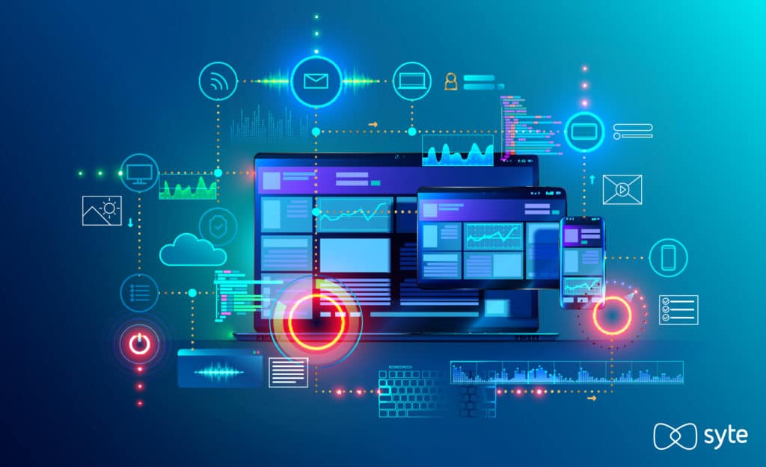
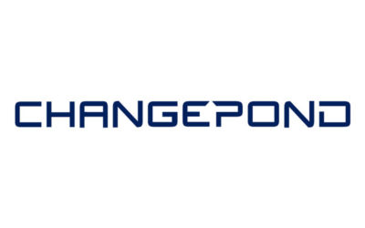
WELCOME
Notes:
To use this title animation slide with a new image simply 1) move the top semi-transparent shape to the side, 2) delete placeholder image, 3) click on the picture icon to add a new picture, 4) Move semi-transparent shape back to original position, 5) Update text on slide.

Slide 2
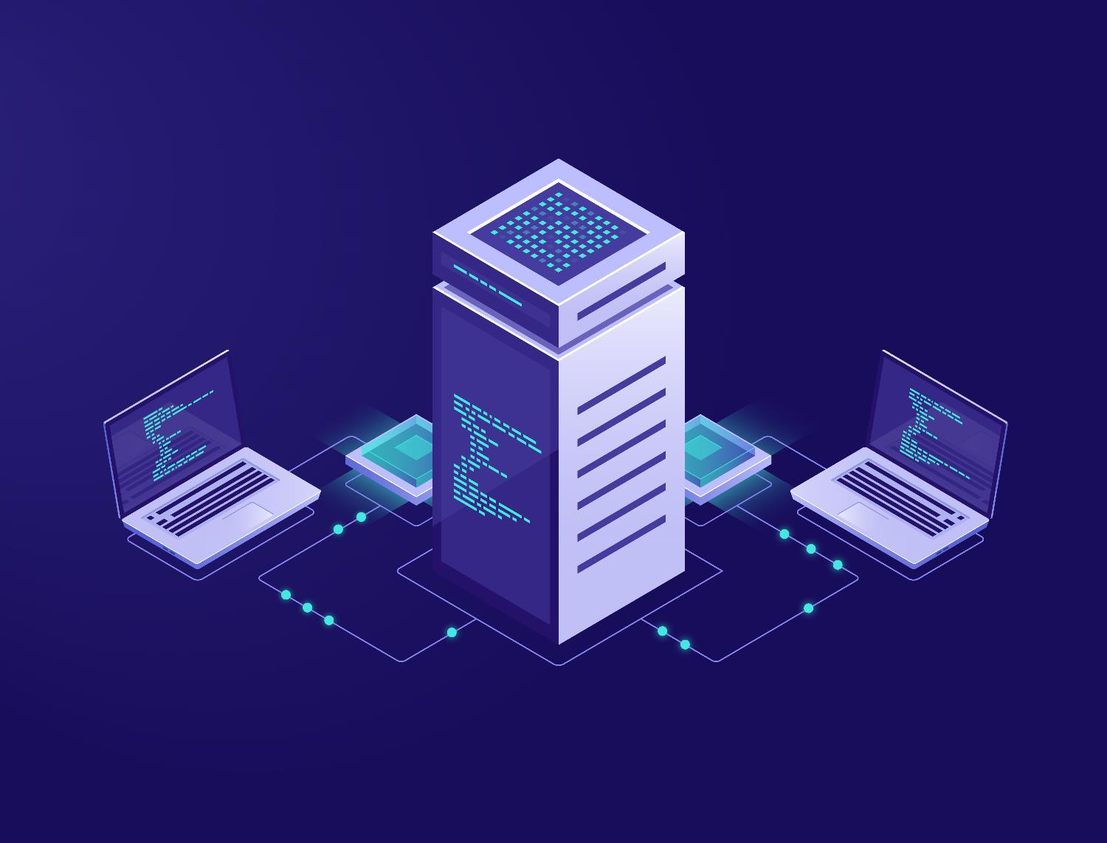
INTRODUCTION
1. .NET FRAMEWORK
2. TESTING
2.1 MANUAL TESTING
2.2 AUTOMATION
3. DATABASE
4. APPLICATION PROGRAMMING INTERFACE ( API )

Slide 3
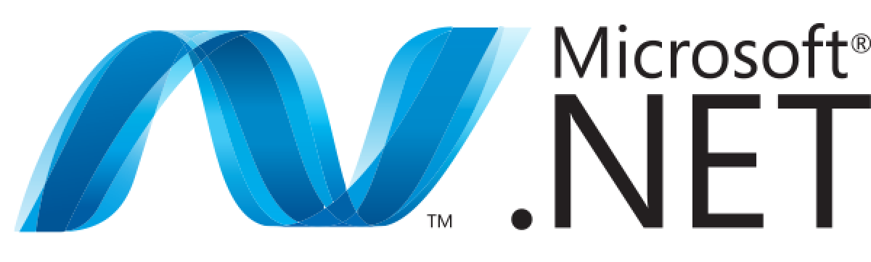
WWW
WHAT? WHY? WHERE?

Slide 4
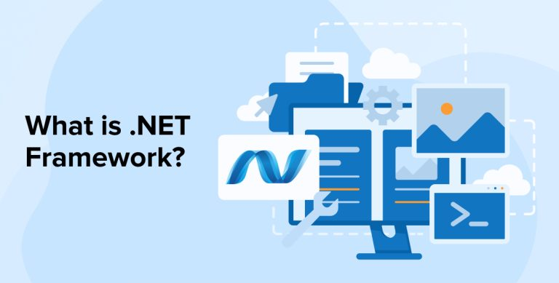
WHAT IS .NET FRAMEWORK
Software Development Framework
Multiple Programming Languages
C#
VB.NET
F#.NET
C++.NET
Latest Version - 9.0
60 programming languages.
11 programming languages – Microsoft

Slide 5
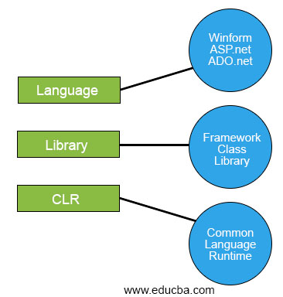
.NET FRAMEWORK
MAIN COMPONENTS OF .NET FRAMEWORK
There are Two major main components of .NET Framework are :
Common Language Runtime(CLR)
.NET Framework Class Library (FCL)

Slide 6
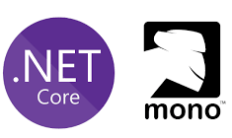
.NET FRAMEWORK
.NET APPLICATION PLATFORM DEPENDENT OR PLATFORM INDEPENDENT?
Platform-dependent
MONO FRAMEWORK:
Cross-platform framework
Developed by Novell
Windows, macOS, Linux.

Slide 7
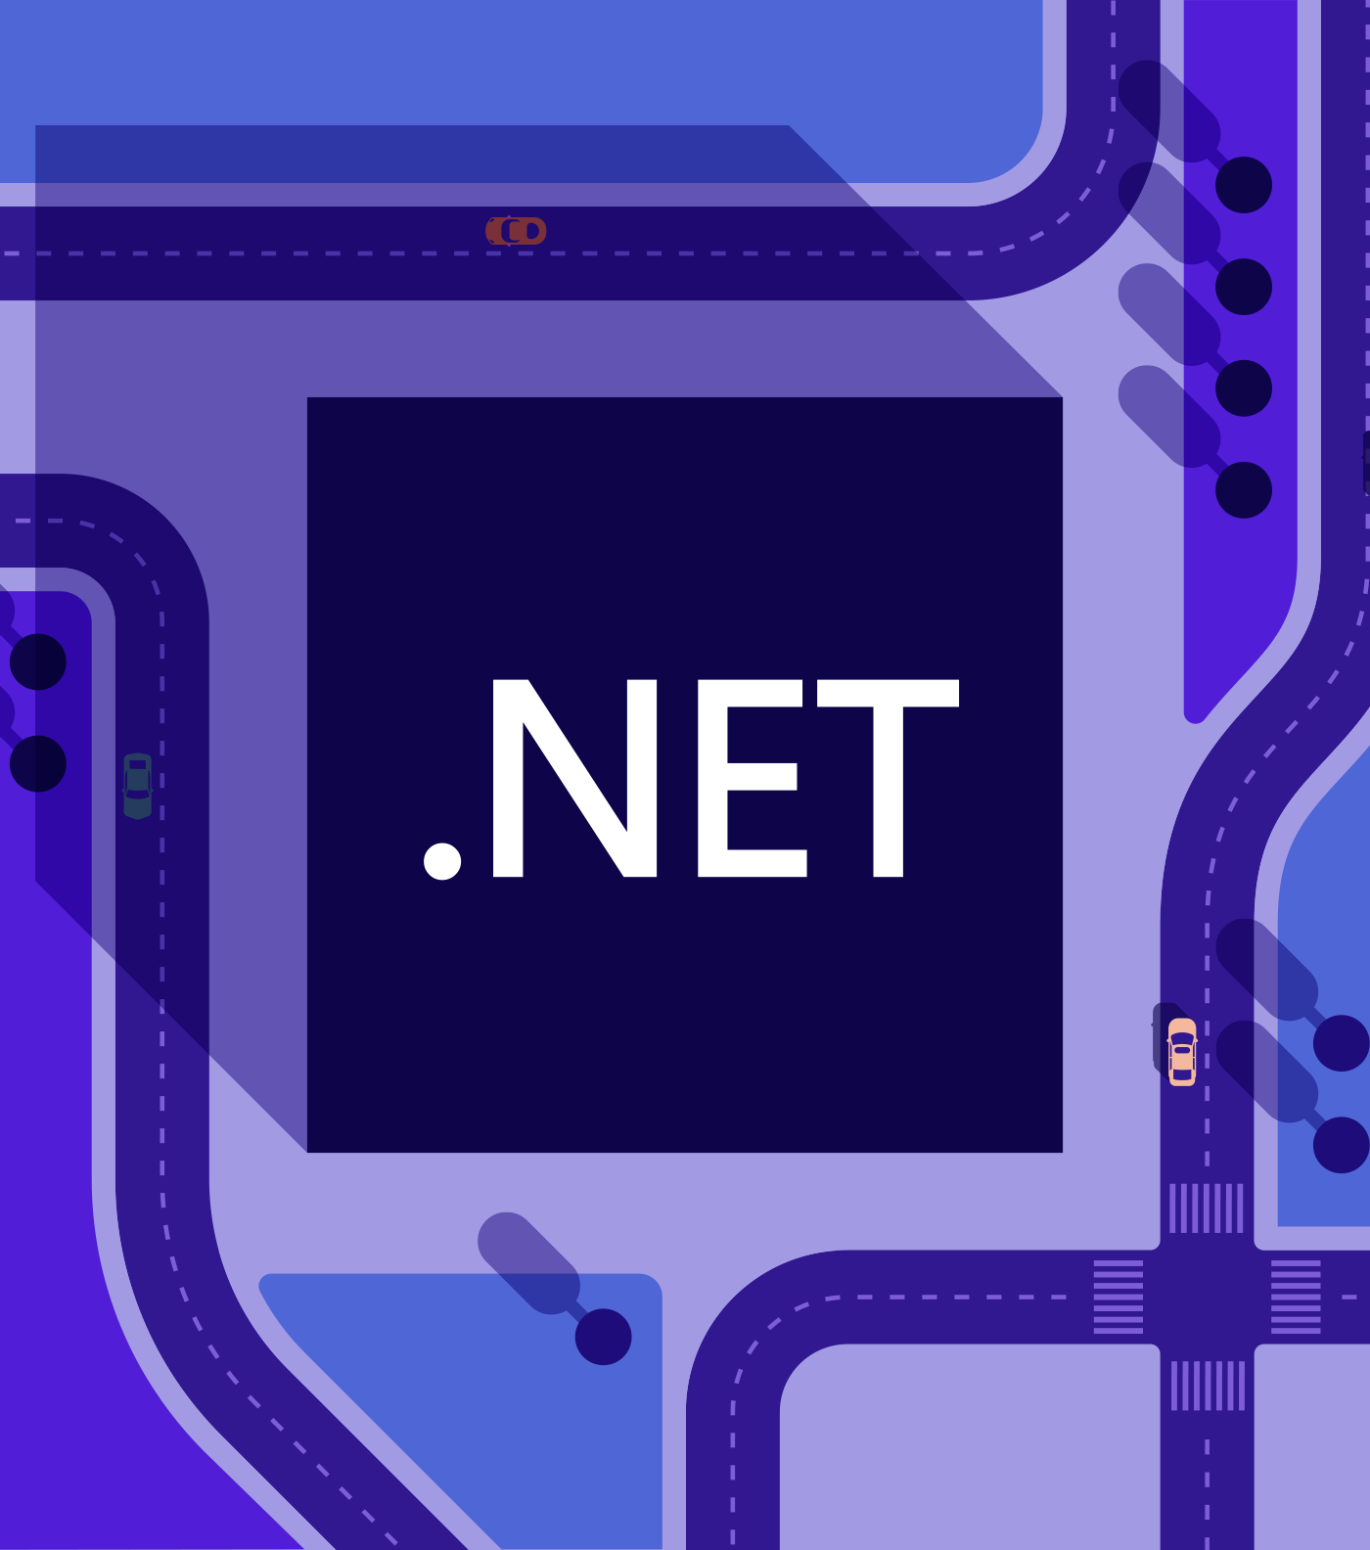
EVOLUTION OF .NET
There are three significant phases of the development of .NET.
OLE Technology
COM Technology
.NET Technology

Slide 8
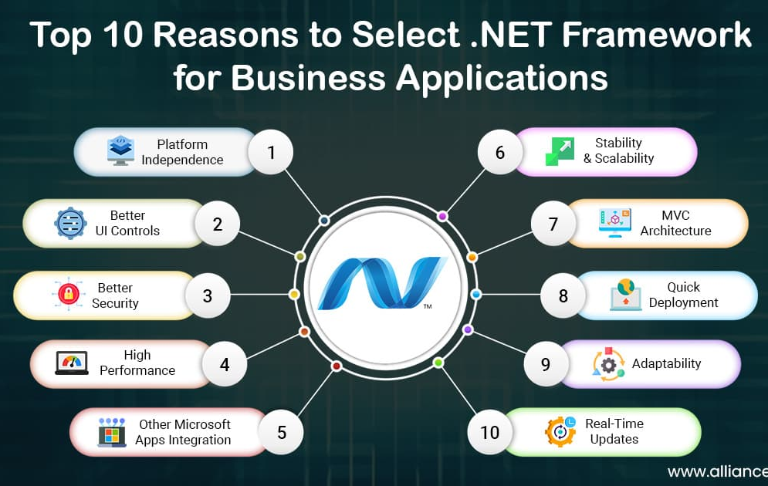
.NET FRAMEWORK
WHY .NET FRAMEWORK
Platform Independence
Better UI
Security
High performance
Language Support

Slide 9
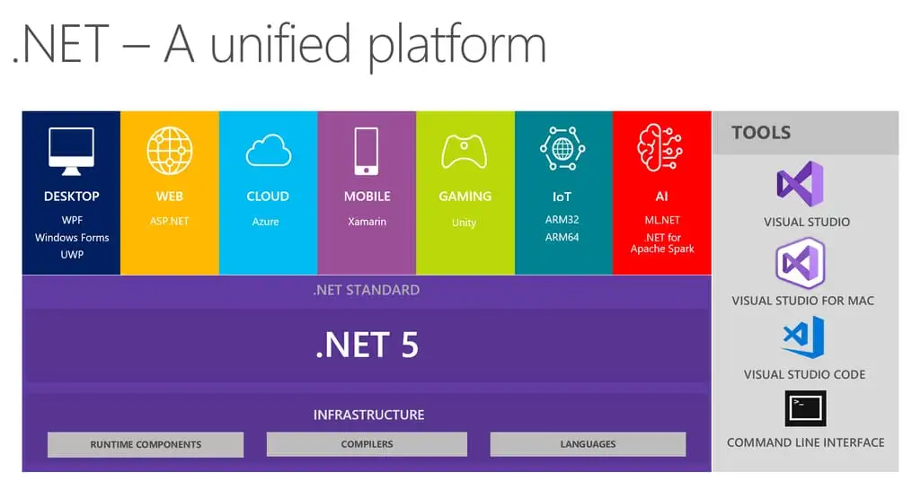
WHERE .NET FRAMEWORK ?
WHERE .NET FRAMEWORK
Web Applications
Console Applications
Mobile Applications
Cloud Applications
Game Development
Cross-Platform Development

Slide 10
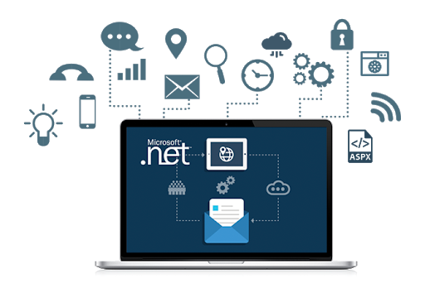
.NET FRAMEWORK ?
ADVANTAGES :
Multi-Language Support
Cross-Platform Compatibility
Large and Active Developer Community
Security Features
DISADVANTAGES :
Windows Dependency
Large Footprint
Licensing Costs Security Features

Slide 11
SOFTWARE TESTING
SOFTWARE TESTING:
Software Testing Is A Process To
Identify Errors and Ensure The Software
Meets Requirements.
Helps Improve Quality.
Increases Customer Confidence.
TYPES OF SOFTWARE TESTING:
Manual Testing
Automation Testing

Slide 12
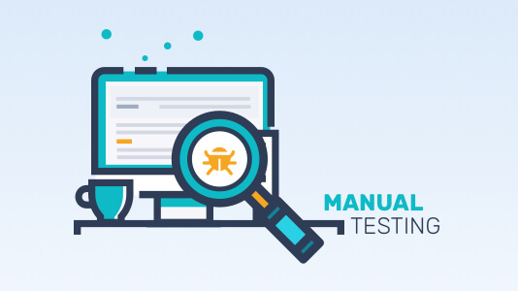
SOFTWARE TESTING
MANUAL TESTING:
Manual Testing Is The Process Of Testing
Software Manually To Identify Defects.
Testers Execute Test Cases Without
Automation Tools.
It Helps Find UI, Usability And Logical
Errors.

Slide 13
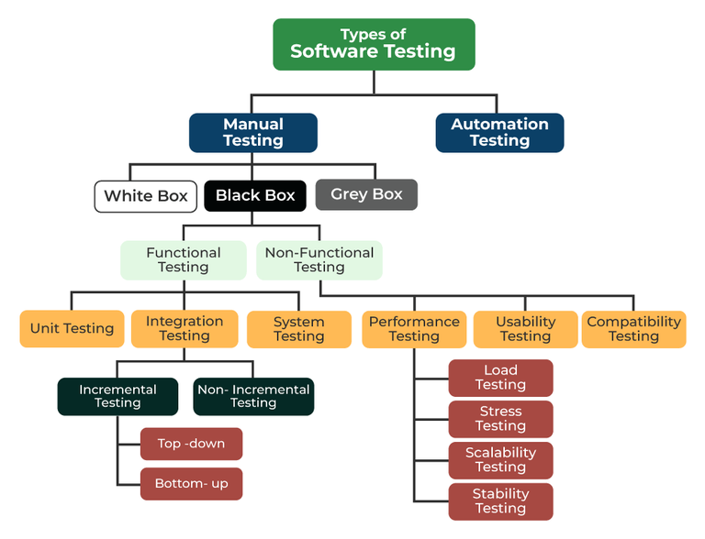
SOFTWARE TESTING

Slide 14
SOFTWARE TESTING
ADVANTAGES OF MANUAL TESTING:
Simple And Cost Effective For Small Projects
Best For UI/UX And Exploratory Testing
Human Intuition Can Find Unexpected Issues
LIMITATIONS OF MANUAL TESTING:
Time Consuming And Less Efficient
Not Suitable For Large Repetitive Tasks
Prone To Human Error

Slide 15
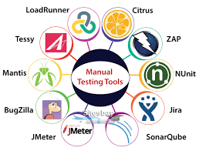
SOFTWARE TESTING
TOOLS OF MANUAL TESTING:
Jira: A popular project management tool with features for bug tracking and test case management.
Bugzilla: An open-source bug tracking system.
Mantis: Another open-source bug tracking system.
ALM Quality Center (Micro Focus): A test management and execution tool.
Tessy: Specialized manual testing tool for embedded systems.
Marker.io: A tool for capturing screenshots and videos to report bugs

Slide 16
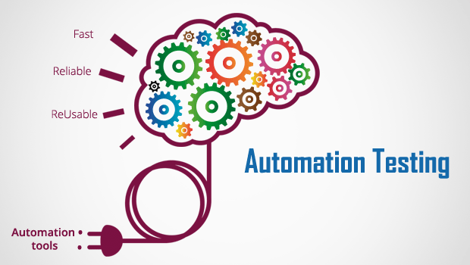
SOFTWARE TESTING
AUTOMATION TESTING:
Automation Testing Involves Using Tools And Scripts To Perform Tests Automatically.
Faster And More Efficient Than Manual Testing
Ideal For Repetitive Test Cases

Slide 17
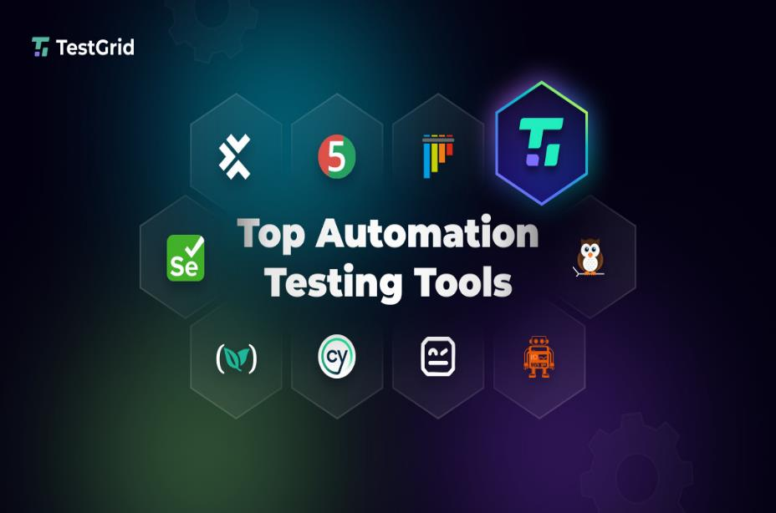
SOFTWARE TESTING
TOOLS FOR AUTOMATION TESTING:
Selenium
TestNG
JUnit
Cucumber
Appium(for Mobile Apps)

Slide 18
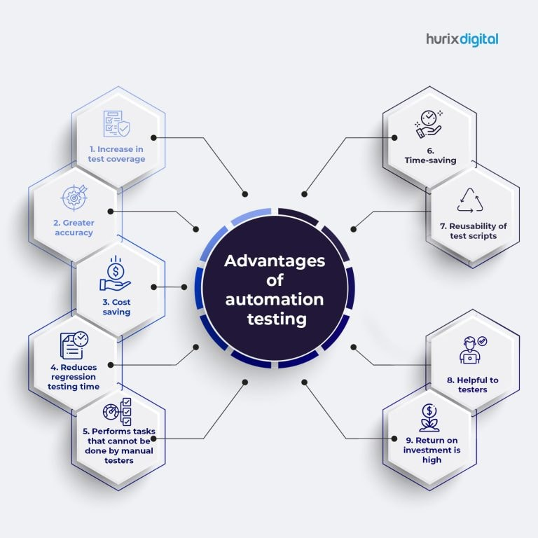
SOFTWARE TESTING
BENEFITS OF AUTOMATION TESTING:
Saves Time And Effort
Increases Test Coverage
Enhances Accuracy And Reliability
Supports Continuous Integration(ci)

Slide 19

SOFTWARE TESTING
CHALLENGES OF AUTOMATION TESTING:
Initial Setup Cost And Time
Requires Skilled Testers
Not Suitable For All Testing Types(e.g,Exploratory)

Slide 20
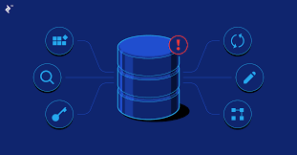
DATABASE(DBMS)
DATA:
Data Is A Collection Of Information.
DATABASE:
A Database Is An Organized Collection Of Data, Stored Electronically And Managed By A Database Management System (DBMS).

Slide 21
DATABASE(DBMS)
Why It Is Important?
Efficient Scaling
-Can Handle Massive Amount Of Data
Data Integrity
-It Has Built-in Rules And Conditions That Ensures Data Consistency And Accuracy.
Data Security
-Protects Sensitive Information.
Data Analytics
-Modern Database Supports Analytical Tools.

Slide 22
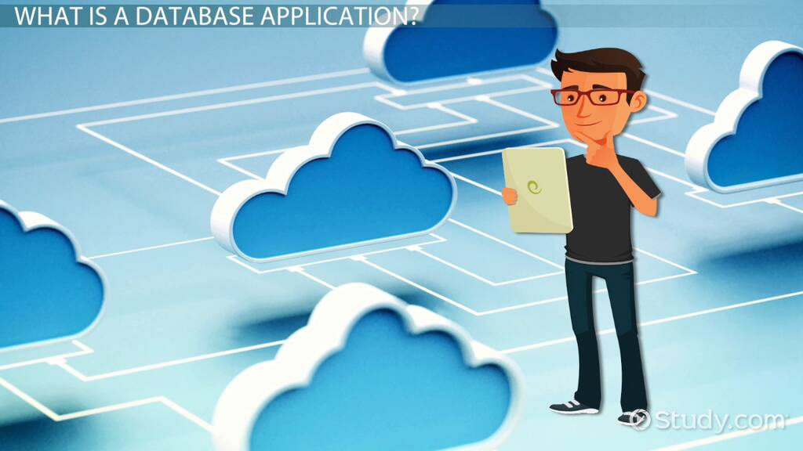
DATABASE(DBMS)
DATABASE APPLICATIONS:
Banking – Managing Customer Accounts And Records.
Retail – Monitor Sales, Inventory, Customer Preference.
Healthcare – Store Patient Records And Medical History.
Education – Maintain Student Data.

Slide 23
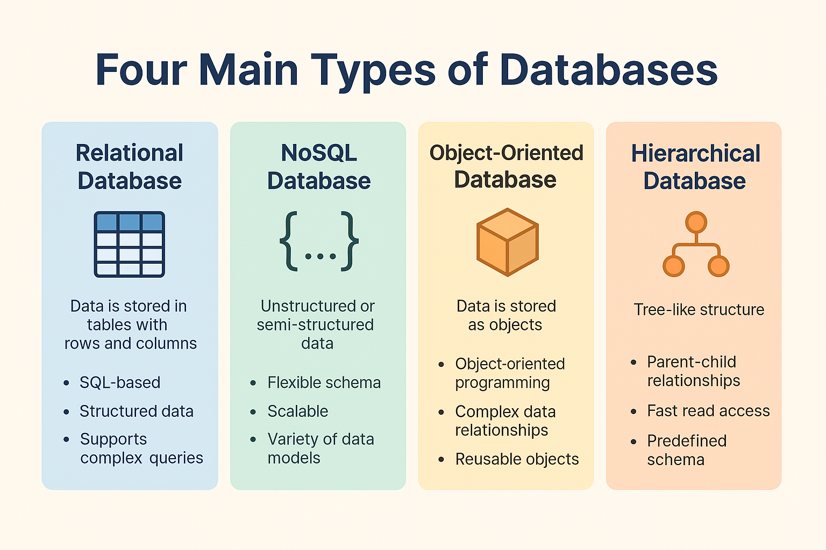
DATABASE(DBMS)
TYPES OF DATABASE:

Slide 24
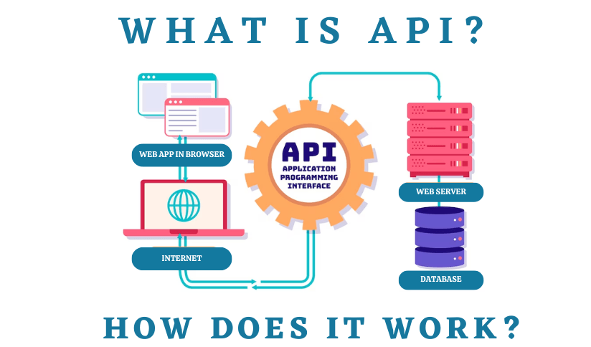
APPLICATION PROGRAMMING INTERFACE
(API)
WHAT IS AN API?
API – Allows To Communicate With Application Each Other.
API Are The Building Blocks For The
Website In Which Heavy Data Is Transferred.
WHY DO WE NEED API?
API Helps Developer To Create Software More Easily
API Are Also Crucial In Building Modern Websites Where Heavy Data Transfer Happened B/W Client And Server.

Slide 25
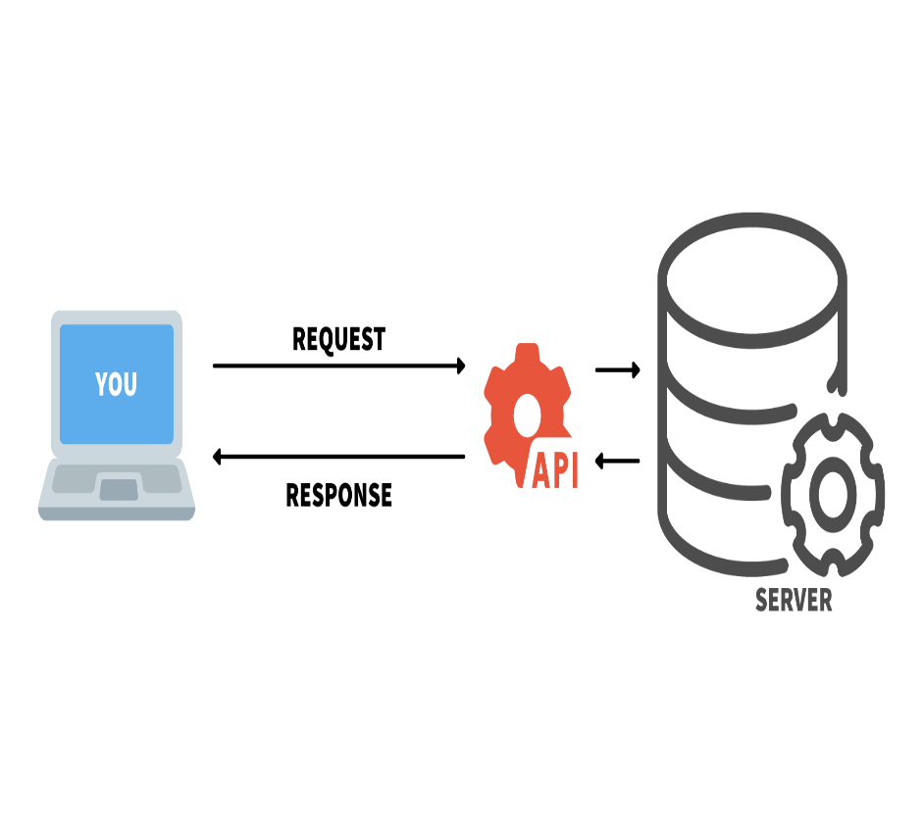
APPLICATION PROGRAMMING INTERFACE
(API)
HOW DO API WORKS?
Request –> Processing –> Response –> Delivery
TYPES OF API:

Slide 26
APPLICATION PROGRAMMING INTERFACE
(API)
WHAT IS WEBSERVICE?
It Is Used For Exchanging Data B/W Applications With Support Of Protocol And Standard Via Internet.
Main Component Of Webservice Is Data Which Is Transferred B/W The Client And The Server And That Is XML.
HOW API DIFFER FROM WEB SERVICE?
All Webservices Are API But Not All API Are Webservice.

Slide 27
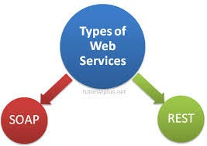
APPLICATION PROGRAMMING INTERFACE
(API)
SOAP:
Format for sending and receiving message
SOAP is platform independent, developed by Microsoft.
It is the best way to communicate b/w applications
REST:
Usually JSON is the most widely used format.
Basic rest request – GET, POST, PUT, DELETE.

Slide 28
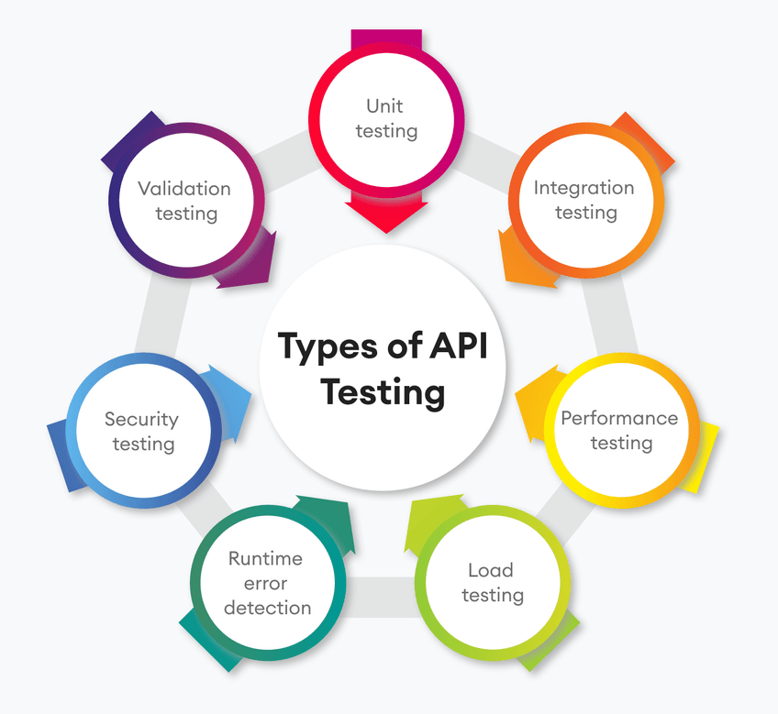
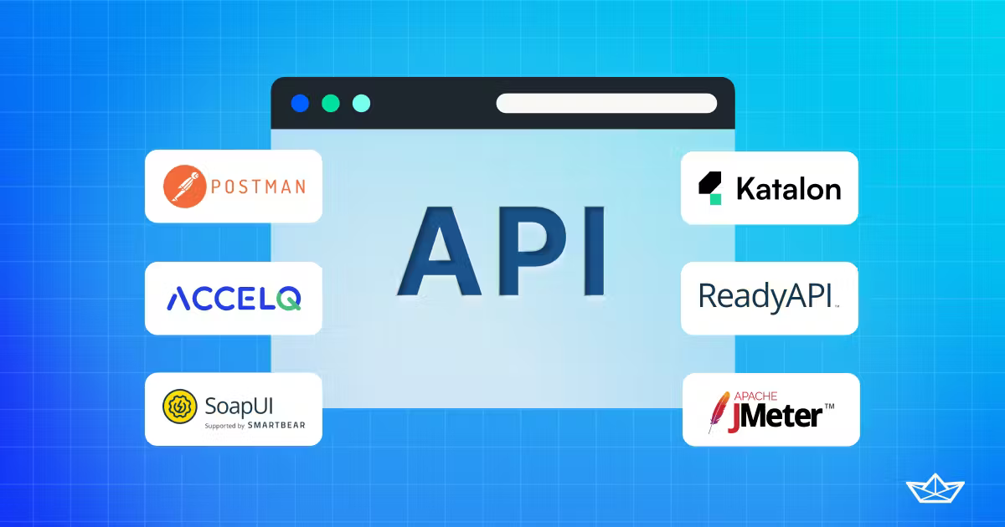
APPLICATION PROGRAMMING INTERFACE
(API)
TYPES OF API TESTING:
TYPES OF TESTING TOOLS:

Slide 29
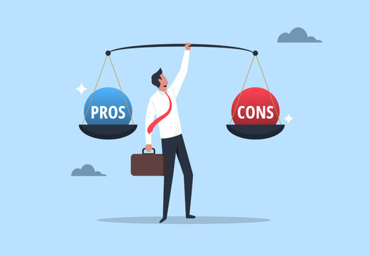
APPLICATION PROGRAMMING INTERFACE
(API)
ADVANTAGES:
Efficiency
Flexible Delivery Of Service
Integration
Automation
DISADVANTAGES:
Cost
Security Issues

Slide 30
THANK YOU!

